Slide 1

TDI LOAN DATA
BY
OGUANYIA CYNTHIA CHIAMAKA

Slide 2
INTRODUCTION
The Data Immersed (TDI), a financial services company specializing in providing loans to individuals and small businesses to aid in meeting up with some necessary basic needs at a particular point in time. The datasets analyzed includes: the interest rate for the loan borrowed, the length of employment, ownership status and the loan approval status, this dataset was provided by The Data Immersed (TDI).

Slide 3
PROBLEM STATEMENT
The company is looking to understand its loan portfolio better, identify risk factors, and improve customer satisfaction through an effective distribution of loans across different employment levels.

Slide 4
RECOMMENDATION
Diversify loan portfolio to reduce risk
Focus on growing specific loan purposes like renewable energy and education.
Target high-income borrowers in specific regions ie. South and west with countries like Florida, Delaware, Arizona, and Colorado.
Verification impact on loan amounts
Enhance offers for senior career borrowers

Slide 5
OBJECTIVES
Loan Data Analysis Dashboard that will provide insights into the company’s loan performance.
To access the loan approval processes and the interest rates across all customer segements.
To be able to assess the risk management status of the loan across the employee status.
To analyze the default payments across different customer segements based on their region and purpose of loan.

Slide 6
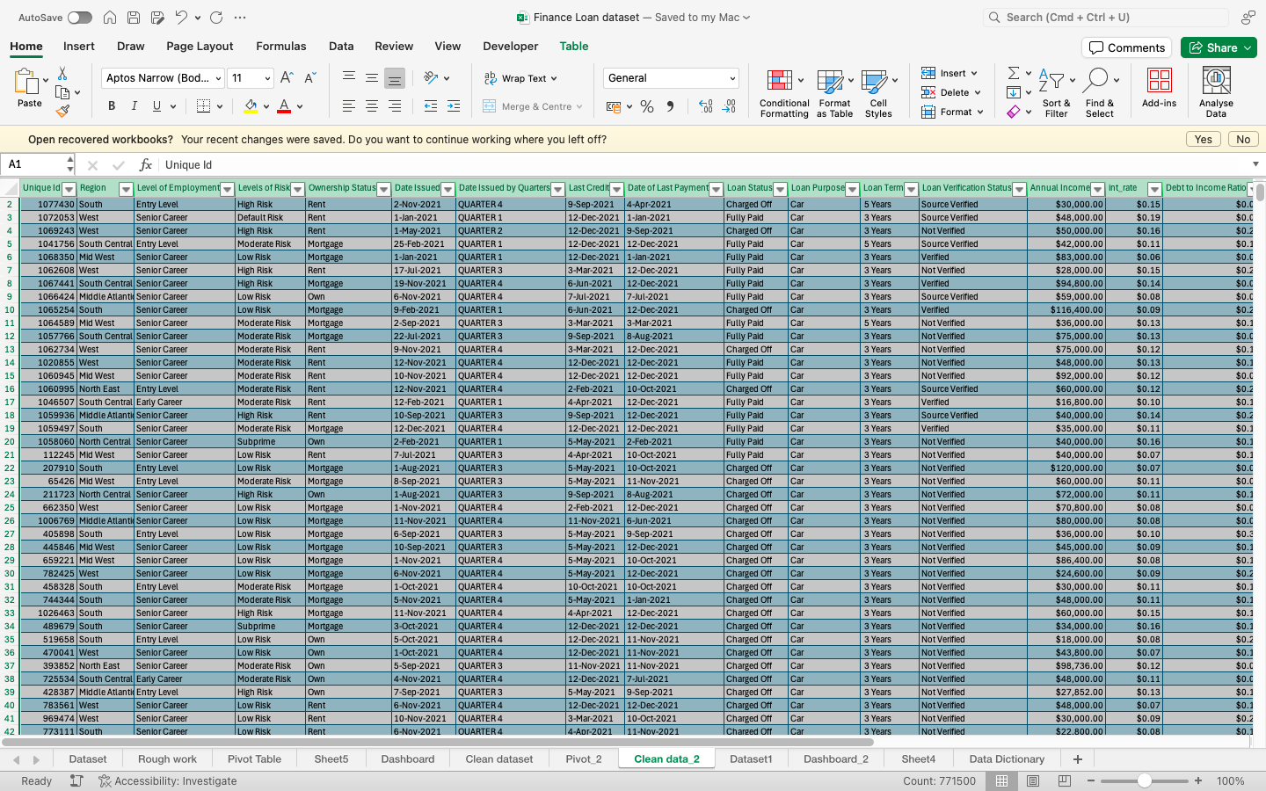
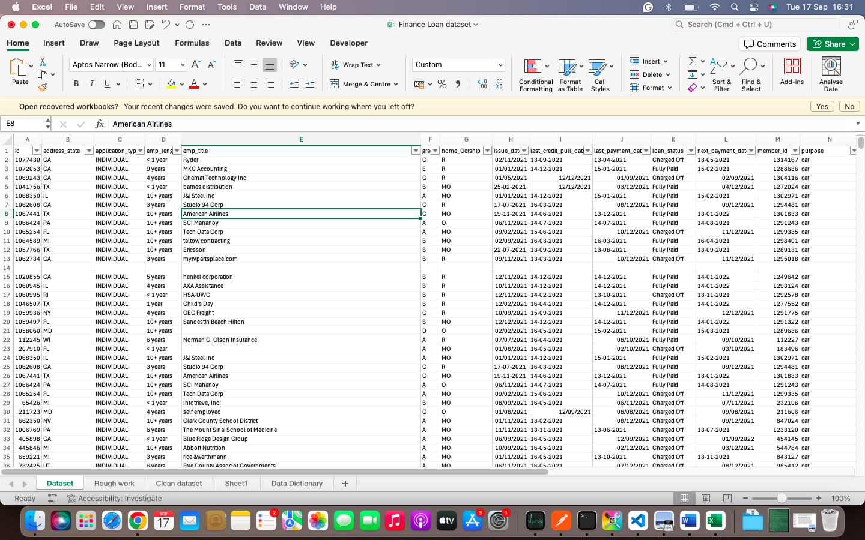
DATA CLEANING
THE DATASET AFTER CLEANING
THE DATASET BEFORE CLEANING

Slide 7
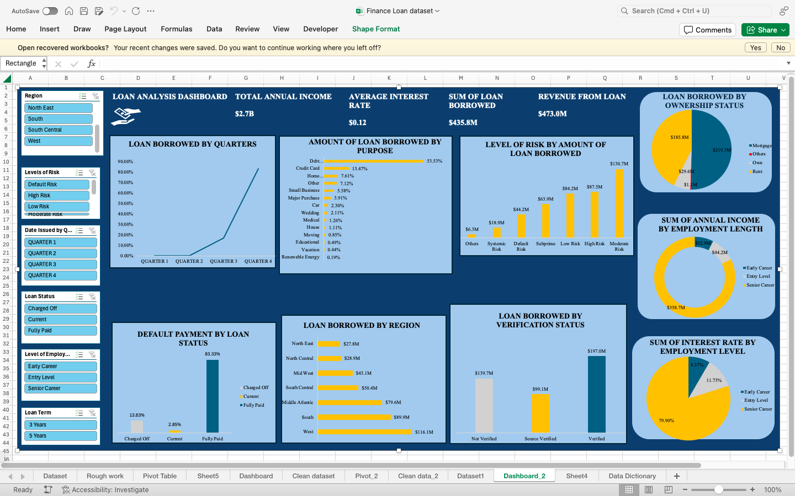
DASHBOARD

Slide 8
INSIGHTS
Potential for Education Loans and Small Business Financing,
Default Risk Differs Based on Loan Status,
Key Borrowers are Those with Longer Employment Tenure.
Reduced Default Risk for Extended-Term Debtors.
High Demand for Loans Associated with Debt.

Slide 9
CONCLUSION
It was observed that more than 66% of the loans taken out were used for credit card repayment and debt consolidation. It is evident that a large number of borrowers are utilising their loans to pay off other debt, possibly signalling a greater dependency on credit, which could result in a default risk if not handled correctly. The dashboard displays a portfolio that includes a sizeable portion of high-risk loans together with substantial development opportunities, especially when concentrating on verified borrowers, senior career professionals, and areas with high loan demand.

